Slide 1

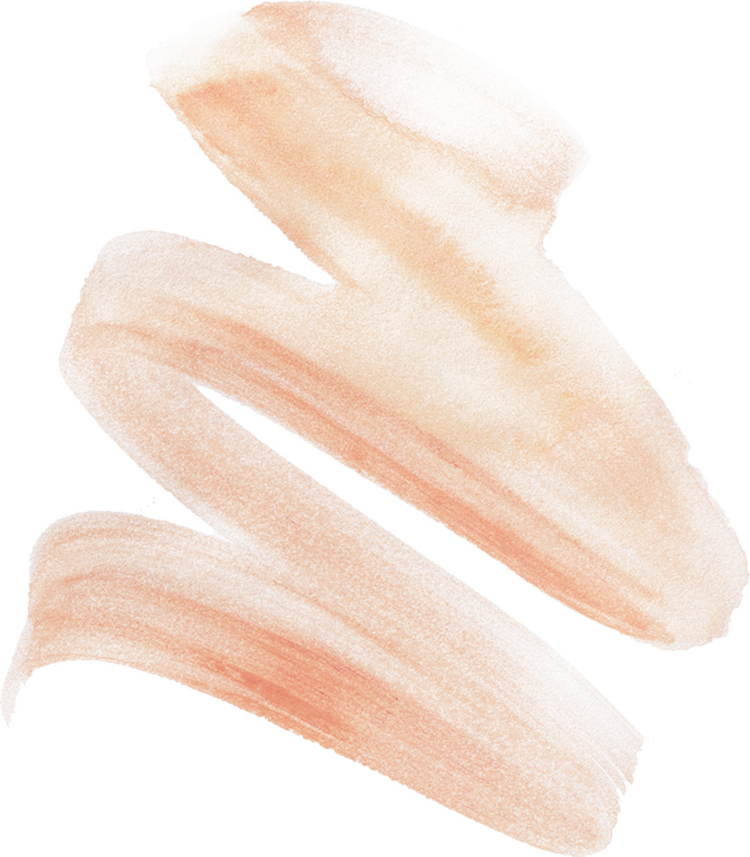
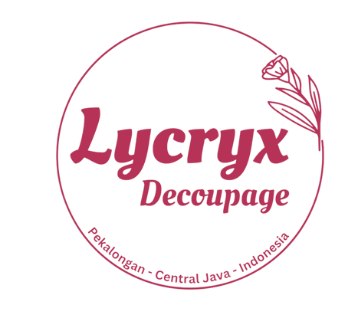
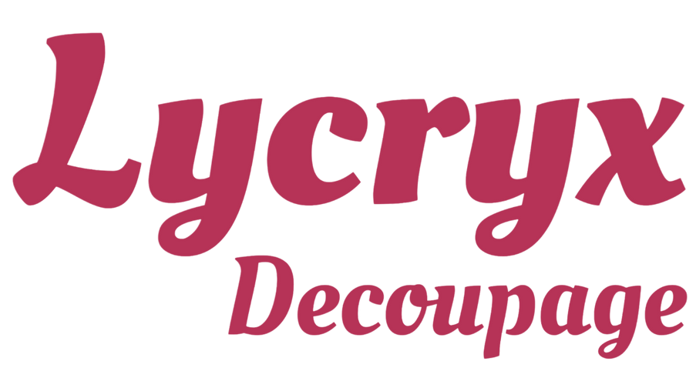
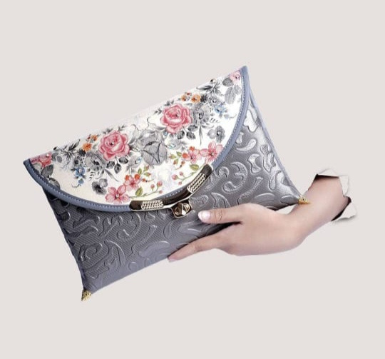



L Y C R YX D E C O U P A G E
catalog
lycryxdecoupage.pkl@gmail.com
+62 856 4010 6027
@lycryxdecoupage.pkl

Slide 2
Brand Lycryx Decoupage
LYCRYX is taken from the Javanese language, namely "likrik / nglikrik" which means that in a process to achieve the desired goal, precision, patience, detail and caution are needed.
This is the same as the decoupage process, which requires precision, patience, detail, and caution
DECOUPAGE is a decorative art that involves cutting and pasting pieces of paper with designs or drawings on the surface of an object, then coating them with several layers of lacquer or glue to give it a smooth, integrated look. This technique is often used to decorate a variety of objects, such as furniture, boxes, vases, and fashion accessories, creating interesting visual effects and unique personalization on decorated objects
lycryxdecoupage.pkl@gmail.com
+62 856 4010 6027
@lycryxdecoupage.pkl

Slide 3
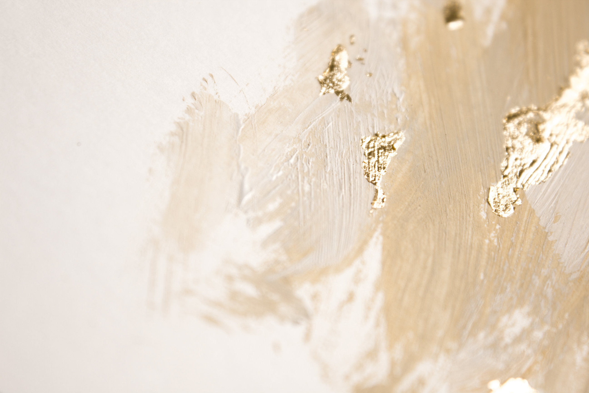
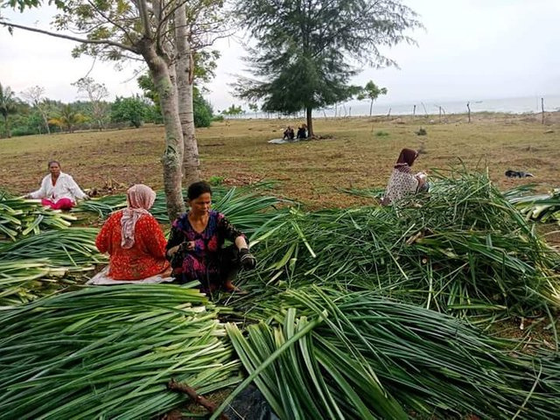
Pandan Duri
46012900
Pandanus is a member of the Pandanaceae which has a fairly wide distribution.
This pandan can be found in various places ranging from sandy beaches to
highland forests with an altitude of about 3,500 m above sea level,
Starting from secondary forests to grasslands with a variety of wet soil patterns
lush humus, lime, peat swamps to sandy soils that are relatively dry and
Few nutrients
Thorny pandan plants in Java
It is generally cultivated to take the leaves as a raw material for weaving.
Pandan weaving is one of the various crafts that needs to be maintained
and preserved
lycryxdecoupage.pkl@gmail.com
+62 856 4010 6027
@lycryxdecoupage.pkl

Slide 4
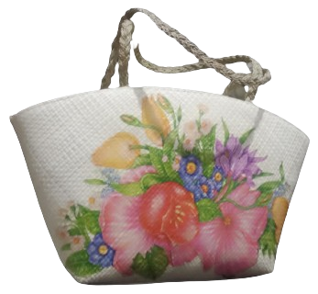
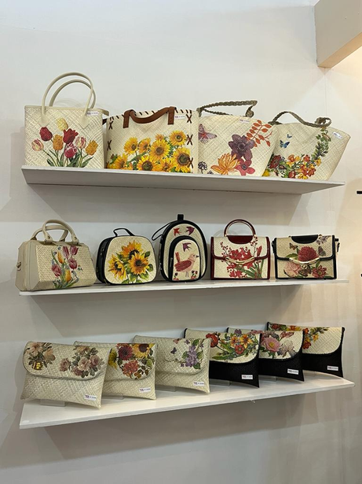
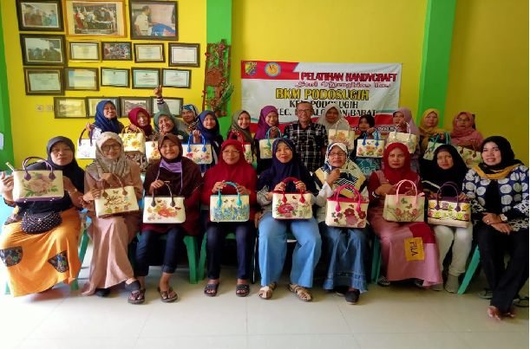
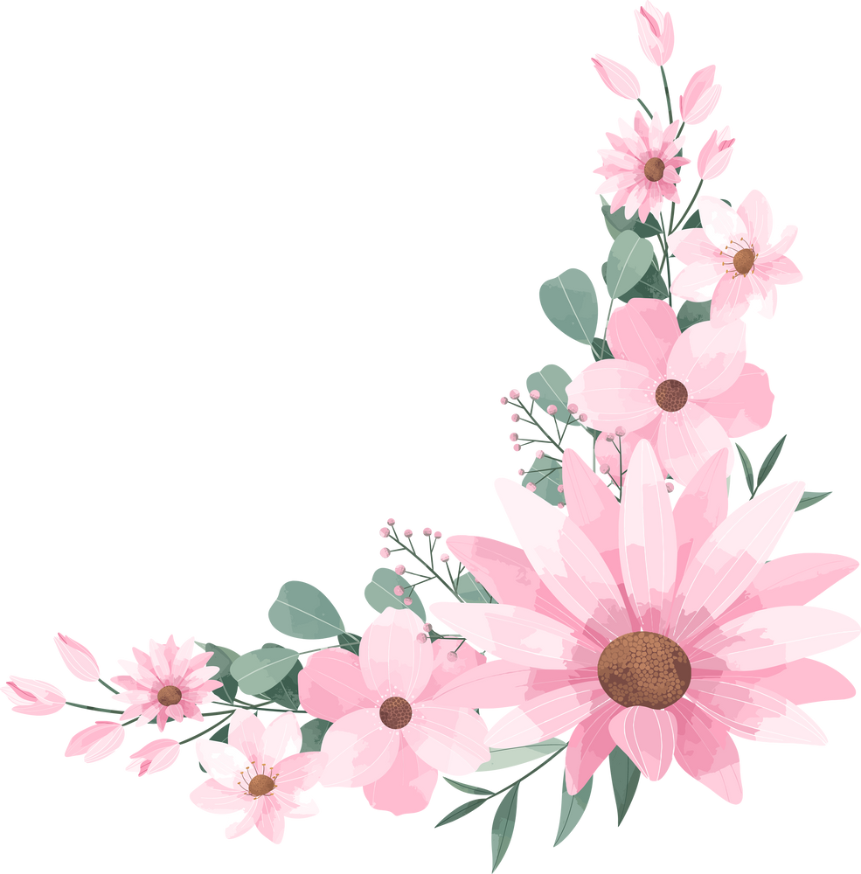
Products Uniqueness
Combination with Other Natural Materials
Custom Orders
Eco-Friendly Materials
Women's Empowerment

Slide 5
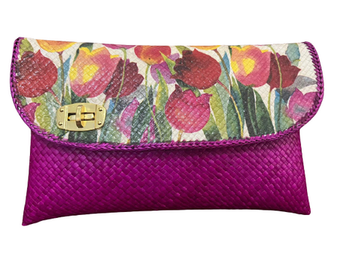
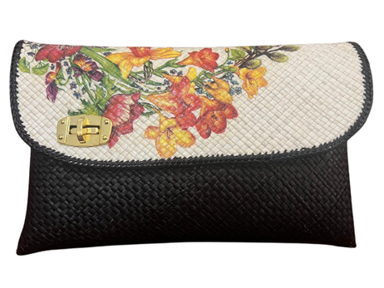
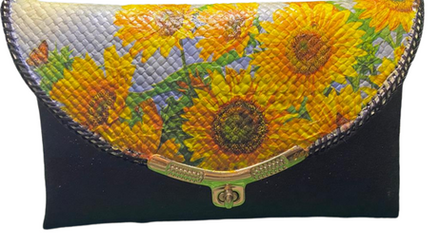
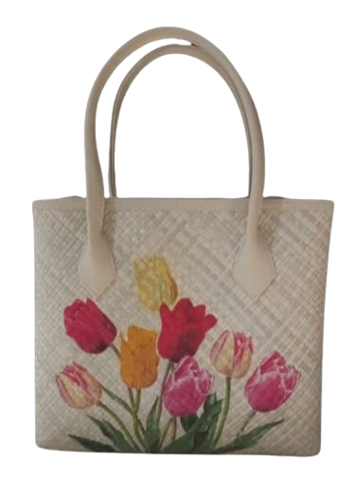
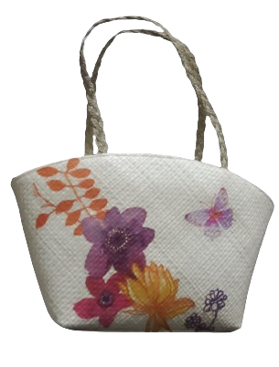
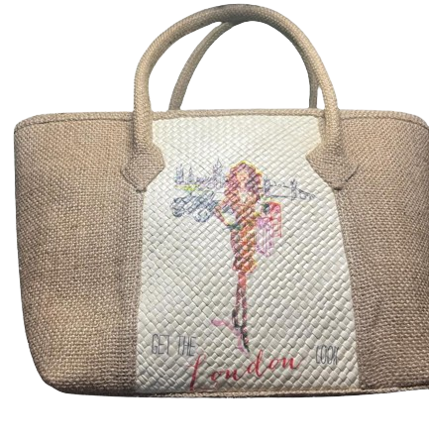
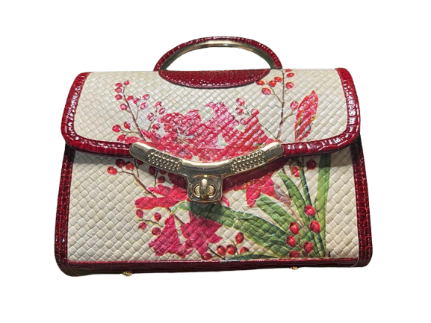
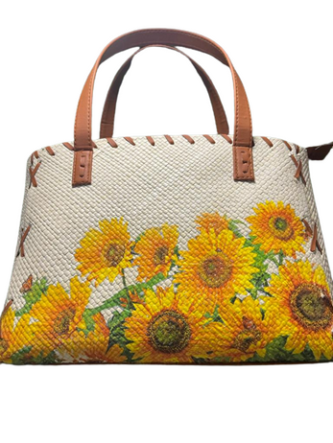
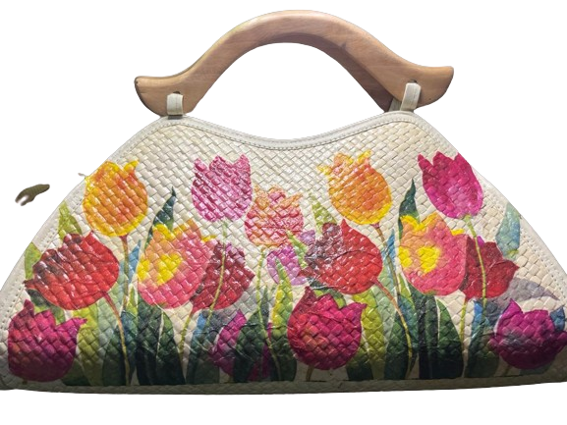
46012900
Style
Fashion
LYCRYX DECOUPAGE
Our Product
lycryxdecoupage.pkl@gmail.com
+62 856 4010 6027
@lycryxdecoupage.pkl

Slide 6
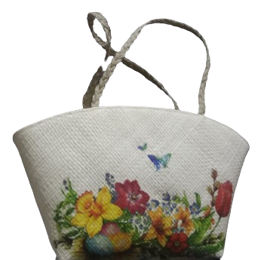
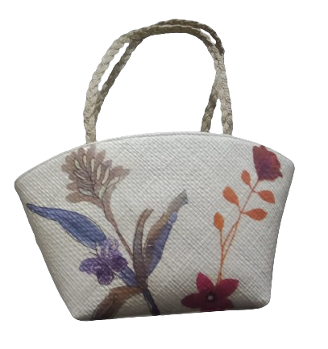
Tessa Decoupage
46012900
To maintain the beauty and quality of the Bag, store the Bag in a dry area, wrap it in a cloth to protect it from dust, and clean it regularly using a cloth or soft tissue.
lycryxdecoupage.pkl@gmail.com
+62 856 4010 6027
@lycryxdecoupage.pkl

Slide 7
Tessa Decoupage
46012900
The Tessa Decoupage bag is the perfect fashion choice for those of you who want to look stylish when hanging out with friends or when heading to the office, with a trendy and elegant design, this bag gives a unique artistic touch to each of your looks, making it a versatile accessory and attracting attention at every occasion.
Material: Full Pandan Leaf Woven
Color : Bone White/Natural White
Size : XL (Pj 50 cm, lb 12 cm, Tg 21 cm)
Accessories : Zipper (59 cm), Strap (42 cm)
Weight : 250 gr
Motif : Flower
Production Capacity : 250 pcs plus decoupage/month
Production Process Time : 1 month
To maintain the beauty and quality of the Bag, store the Bag in a dry area, wrap it in a cloth to protect it from dust, and clean it regularly using a cloth or soft tissue.
lycryxdecoupage.pkl@gmail.com
+62 856 4010 6027
@lycryxdecoupage.pkl

Slide 8
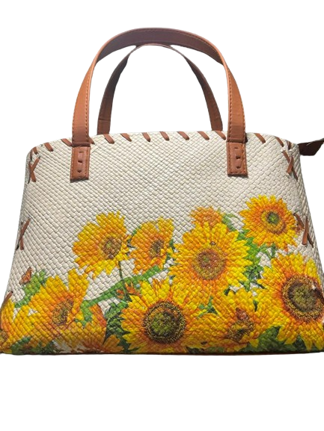
46012900
Webee Decoupage
Sun Decoupage
Princess Decoupage
Jessica Decoupage
  To maintain the beauty and quality of the Bag, store the Bag in a dry area, wrap it in a cloth to protect it from dust, and clean it regularly using a cloth or soft tissue.
lycryxdecoupage.pkl@gmail.com
+62 856 4010 6027
@lycryxdecoupage.pkl

Slide 9
Sun Decoupage
46012900
Sun Decoupage bags are a loyal companion for housewives, college students and career mothers, offering comfort, functionality and power in one package. With a lightweight design, able to hold a lot of items, and sturdy, this bag will be a loyal companion in completing daily tasks with ease and maintaining style.
Material: Full Pandan Leaf Woven
Color : Bone White/Natural White
Size : Pj 50 cm, Lb 12 cm, Tg 21 cm
Accessories : Zipper (30 cm), Strap (size 59 cm, brown)
Weight : 270 gr
Motif : Flower
Production Capacity : 50 units/month (Plus Decoupage)
Production Process Time : 1 Month
  To maintain the beauty and quality of the Bag, store the Bag in a dry area, wrap it in a cloth to protect it from dust, and clean it regularly using a cloth or soft tissue.
lycryxdecoupage.pkl@gmail.com
+62 856 4010 6027
@lycryxdecoupage.pkl

Slide 10
Webee Decoupage
46012900
The Webee Decoupage bag is a practical solution for your daily needs, with a lightweight design, yet capable of holding a lot of items. Its simplicity and functionality make it perfect for a variety of formal activities and daily activities.
Material: Full Pandan Leaf Woven
Color : Bone White/Natural White
Size : Pj 27 cm, Lb 12, Tg 23 cm
Accessories : Zippers (24 cm), Straps (45 cm)
Weight : 270 gr
Motif : Flower
Production capacity : 100 units/month (Plus Decoupage)
Production Process Time : 1 month
  To maintain the beauty and quality of the Bag, store the Bag in a dry area, wrap it in a cloth to protect it from dust, and clean it regularly using a cloth or soft tissue.
lycryxdecoupage.pkl@gmail.com
+62 856 4010 6027
@lycryxdecoupage.pkl

Slide 11
Princess Decoupage
46012900
The Princess Decoupage bag is the perfect harmony between the beauty of pandan leaf woven and the power of burlap, creating a product that is unparalleled in uniqueness and style. With its elegance, this bag is an ideal choice for appearing in the office or other formal events, giving an undeniable touch of elegance to any of your looks.
Ingredients: Full Woven Pandan Leaves Combination Goji
Color : Bone White/Natural White Color Combination Brown
Size : Pj 41 cm, Lb 17 cm, Tg 21 cm
Accessories : Zippers (38 cm), Straps (48 cm)
Weight : 275 g
Motif : Princess
Production Capacity : 50 units/month (Plus Decoupage)
Production Process Time : 1 month
  To maintain the beauty and quality of the Bag, store the Bag in a dry area, wrap it in a cloth to protect it from dust, and clean it regularly using a cloth or soft tissue.
lycryxdecoupage.pkl@gmail.com
+62 856 4010 6027
@lycryxdecoupage.pkl

Slide 12
Jessica Decoupage
46012900
Jessica Decoupage's bag is the perfect symbol of elegance, with a signature touch of wood handles that add a natural feel to the design. Perfect for any occasion, from office to social gatherings, from casual walks to glamorous parties, this bag is a great choice to add a fashionable sparkle to your style.
Material: Full Pandan Leaf Woven
Color : Bone White/Natural White
Handle : Wood
Size : Pj 31 cm, Lb 11 cm, Tg 22 cm
Accessories : Zipper (36 cm)
Weight : 120 gr
Motif : Flower
Production Capacity : 50 units/month (Plus Decoupage)
Production Process Time : 2 Months
  To maintain the beauty and quality of the Bag, store the Bag in a dry area, wrap it in a cloth to protect it from dust, and clean it regularly using a cloth or soft tissue.
lycryxdecoupage.pkl@gmail.com
+62 856 4010 6027
@lycryxdecoupage.pkl

Slide 13
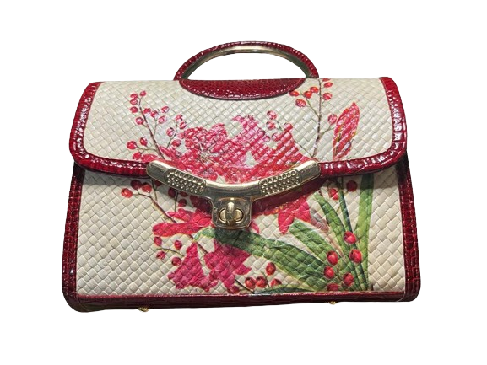
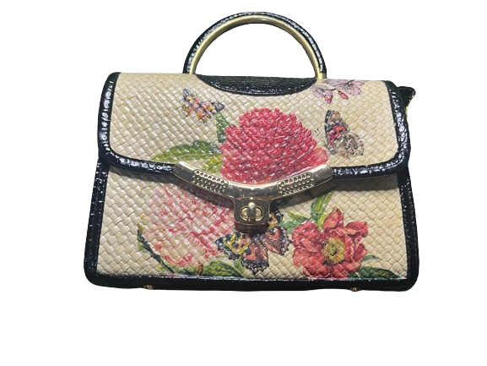
Inces Decoupage
46012900
  To maintain the beauty and quality of the Bag, store the Bag in a dry area, wrap it in a cloth to protect it from dust, and clean it regularly using a cloth or soft tissue.
lycryxdecoupage.pkl@gmail.com
+62 856 4010 6027
@lycryxdecoupage.pkl

Slide 14
Inces Decoupage
46012900
This decoupage Inces bag presents an elegant impression with a simple design, making it the perfect choice for both formal and casual events. With an alluring artistic touch, this bag adds style and elegance to every look you look
Material: Combination of Woven Pandan Leaves & Imitation Croco
Color : Bone White/Natural White & Red
Handle : Copper wrapped in imitation croco material
Size : Pj 23 cm, Lb 9 cm, Tg 17 cm
Accessories : Strap (134 cm)
Weight : 265 gr
Motif : Flower
Production Capacity : 50 units/month (Plus Decoupage)
Production Process Time : 2 Months
  To maintain the beauty and quality of the Bag, store the Bag in a dry area, wrap it in a cloth to protect it from dust, and clean it regularly using a cloth or soft tissue.
lycryxdecoupage.pkl@gmail.com
+62 856 4010 6027
@lycryxdecoupage.pkl

Slide 15
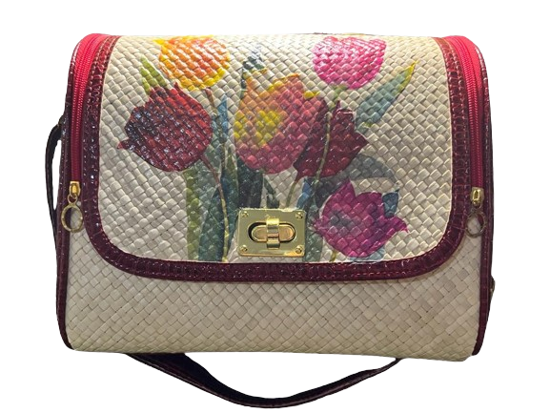
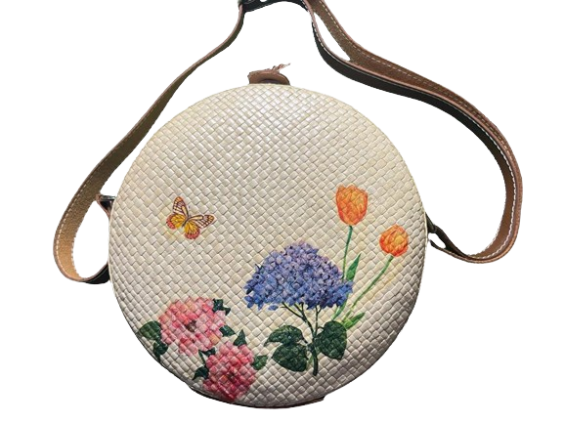
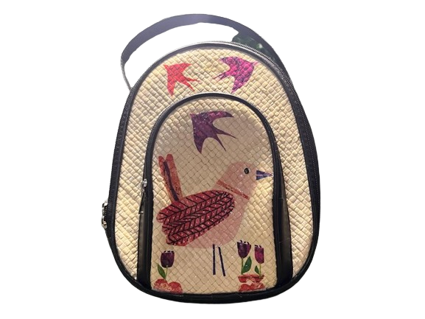
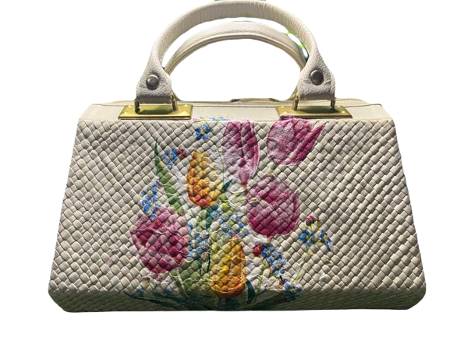
Janet Decoupage
46012900
Canteen Decoupage
Backpack Decoupage
Elisabet Decoupage
lycryxdecoupage.pkl@gmail.com
+62 856 4010 6027
@lycryxdecoupage.pkl

Slide 16
Elisabet Decoupage
46012900
This tiny Elisabeth decoupage bag is an ideal accessory for young mothers. Designed with an artistic touch, this bag is perfect for completing your look at a party, adding an elegant touch and captivating every eye.
Ingredients: Combination of Pandan Leaf Woven & Croco Imitation
Color : Bone White/Natural White
Handle : Faux croco material
Size : Pj 24 cm, Tg 16 cm
Accessories : Zipper (53 cm), Strap (125 cm)
Weight : 280 gr
Motif : Flower
Production Capacity : 50 units/month (Plus Decoupage)
Production Process Time : 2 Months
  To maintain the beauty and quality of the Bag, store the Bag in a dry area, wrap it in a cloth to protect it from dust, and clean it regularly using a cloth or soft tissue.
lycryxdecoupage.pkl@gmail.com
+62 856 4010 6027
@lycryxdecoupage.pkl

Slide 17
Janet Decoupage
46012900
This Janet decoupage bag is the perfect choice for teens and young moms, with an elegant and versatile design. Perfect for both formal and casual occasions, this bag adds a touch of style to any occasion, ensuring you always look chic and confident.
Material: Full Pandan Leaf Woven
Color : Bone White/Natural White Red Combination
Strap Length : 134 cm, red color, faux croco material
Size : Pj 23 cm, Lb 9 cm, Tg 17 cm
Accessories : Zipper (36 cm) & red wrana
Weight : 265 gr
Motif : Flower
Production Capacity : 50 units/month (Plus Decoupage)
Production Process Time : 2 Months
  To maintain the beauty and quality of the Bag, store the Bag in a dry area, wrap it in a cloth to protect it from dust, and clean it regularly using a cloth or soft tissue.
lycryxdecoupage.pkl@gmail.com
+62 856 4010 6027
@lycryxdecoupage.pkl

Slide 18
Backpack Decoupage
46012900
This simple decoupage backpack bag is specially designed for teenagers and children, with a small but strong size that is suitable for walking. Its unique and practical design ensures comfort while adding style to each of their adventures.
Material: Full Pandan Leaf Woven
Color :Bone White/Natural White & Black Combination
Strap Size : 90 cm
Size : Pj 20 cm, Lb 9 cm, Tg 25 cm
Shape : Oval
Accessories : Zipper (36 cm)
Weight : 100 gr
Motif : Bird
Production Capacity : 50 units/month (Plus Decoupage)
Production Process Time : 2 Months
  To maintain the beauty and quality of the Bag, store the Bag in a dry area, wrap it in a cloth to protect it from dust, and clean it regularly using a cloth or soft tissue.
lycryxdecoupage.pkl@gmail.com
+62 856 4010 6027
@lycryxdecoupage.pkl

Slide 19
Canteen Decoupage
46012900
This circular decoupage bag blends simplicity with artistic uniqueness, making it the perfect accessory to add a touch of elegance to any look. With an unusual yet practical design, this bag ensures that you stand out at every occasion.
Material: Full Pandan Leaf Woven
Color : Bone White/Natural White
Shape : Circle
Size : Bag Circumference 66 cm, Diameter 21 cm, Tg 7 cm
Accessories : Imitation Material Long Straps
Strap Size : 131 cm
Weight : 260 gr
Motif : Flower
Production Capacity : 50 units/month (Plus Decoupage)
Production Process Time : 2 Months
  To maintain the beauty and quality of the Bag, store the Bag in a dry area, wrap it in a cloth to protect it from dust, and clean it regularly using a cloth or soft tissue.
lycryxdecoupage.pkl@gmail.com
+62 856 4010 6027
@lycryxdecoupage.pkl

Slide 20
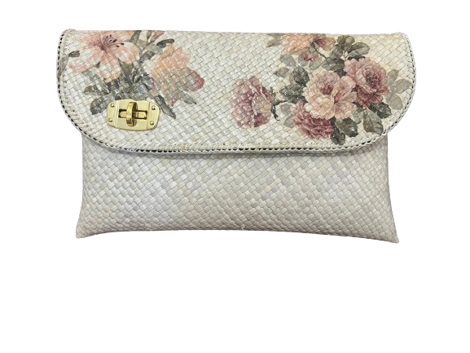
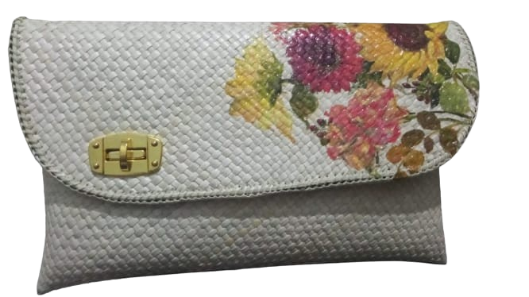
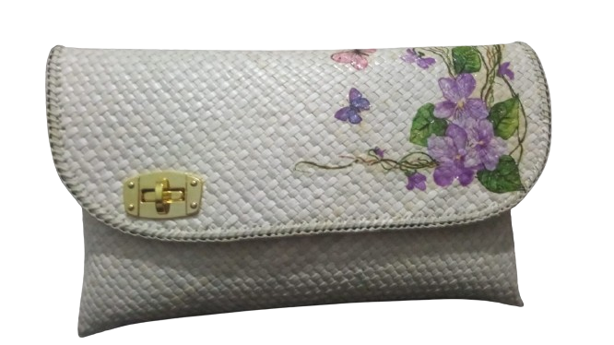
Clutch Decoupage
46012900
  To maintain the beauty and quality of the Bag, store the Bag in a dry area, wrap it in a cloth to protect it from dust, and clean it regularly using a cloth or soft tissue.
lycryxdecoupage.pkl@gmail.com
+62 856 4010 6027
@lycryxdecoupage.pkl

Slide 21
Clutch Decoupage
46012900
Clutch Decoupage, with its elegant and fashionable style, is the ideal choice to enhance your look at parties or when you are on a leisurely walk. Lightweight, simple, and practical, this bag not only makes it easy to carry your essentials, but it also adds a touch of alluring style to your every step
Material: Full Pandan Leaf Woven
Color : Bone White/Natural White
Size : Pj 32 cm, Height 19 cm
Accessories : Chain Strap (113 cm)
Weight : 280 gr
Motif : Flower
Production Capacity : 100 units/month (Plus Decoupage)
Production Process Time : 1 Month
  To maintain the beauty and quality of the Bag, store the Bag in a dry area, wrap it in a cloth to protect it from dust, and clean it regularly using a cloth or soft tissue.
lycryxdecoupage.pkl@gmail.com
+62 856 4010 6027
@lycryxdecoupage.pkl

Slide 22
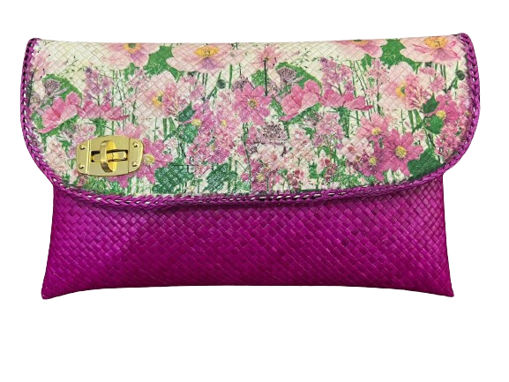
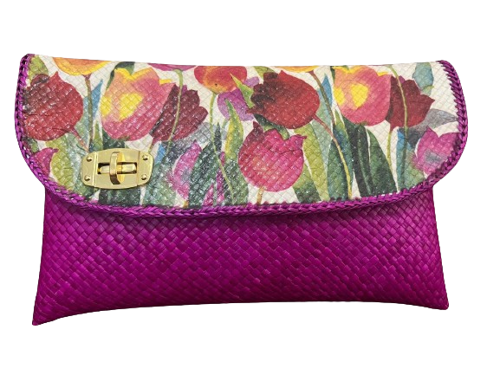
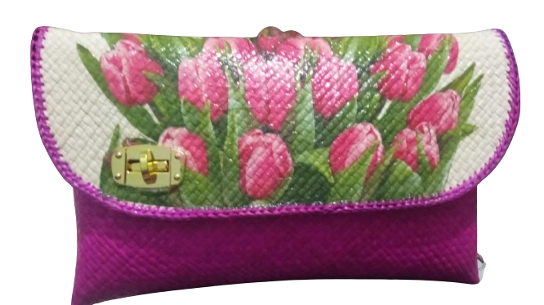
Clutch Decoupage
46012900
  To maintain the beauty and quality of the Bag, store the Bag in a dry area, wrap it in a cloth to protect it from dust, and clean it regularly using a cloth or soft tissue.
lycryxdecoupage.pkl@gmail.com
+62 856 4010 6027
@lycryxdecoupage.pkl

Slide 23
Clutch Decoupage
46012900
Clutch Decoupage is an elegant and fashionable bag, it is very suitable for party and sightseeing events. With a lightweight, simple, and practical design, this clutch is the perfect accessory to complement your look on various occasions.
Material: Full Pandan Leaf Woven
Color : Bone White/Natural White Purple Combination
(Purple, Red, Blue, Black, Pink, Green Color Combination)
Size : Pj 32 cm, Height 19 cm
Accessories : Chain Strap (113 cm)
Weight : 280 gr
Motif : Flower
Production Capacity : 100 units/month (Plus Decoupage)
Production Process Time : 1 Month
  To maintain the beauty and quality of the Bag, store the Bag in a dry area, wrap it in a cloth to protect it from dust, and clean it regularly using a cloth or soft tissue.
lycryxdecoupage.pkl@gmail.com
+62 856 4010 6027
@lycryxdecoupage.pkl

Slide 24
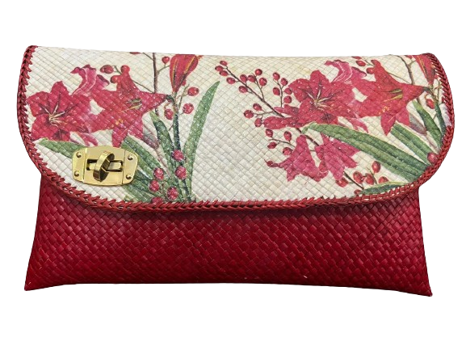
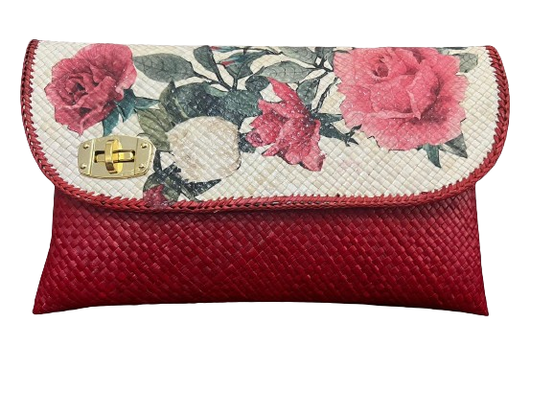
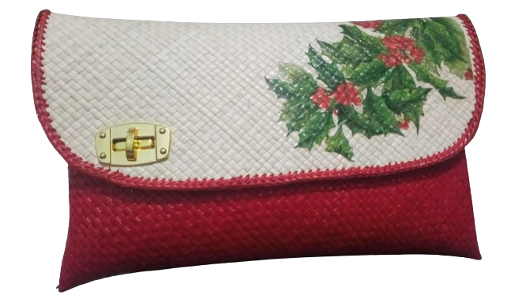
46012900
Clutch Decoupage
  To maintain the beauty and quality of the Bag, store the Bag in a dry area, wrap it in a cloth to protect it from dust, and clean it regularly using a cloth or soft tissue.
lycryxdecoupage.pkl@gmail.com
+62 856 4010 6027
@lycryxdecoupage.pkl

Slide 25
Clutch Decoupage
46012900
Clutch Decoupage is an elegant and fashionable bag, it is very suitable for party and sightseeing events. With a lightweight, simple, and practical design, this clutch is the perfect accessory to complement your look on various occasions.
Material: Full Pandan Leaf Woven
Color : Bone White/Natural White Red Combination
(Purple, Red, Blue, Black, Pink, Green Color Combination)
Size : Pj 32 cm, Height 19 cm
Accessories : Chain Strap (113 cm)
Weight : 280 gr
Motif : Flower
Production Capacity : 100 units/month (Plus Decoupage)
Production Process Time : 1 Month
  To maintain the beauty and quality of the Bag, store the Bag in a dry area, wrap it in a cloth to protect it from dust, and clean it regularly using a cloth or soft tissue.
lycryxdecoupage.pkl@gmail.com
+62 856 4010 6027
@lycryxdecoupage.pkl

Slide 26
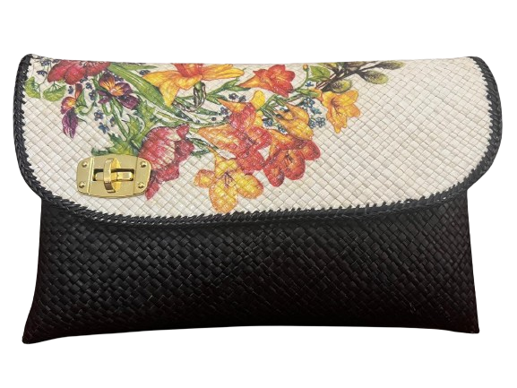
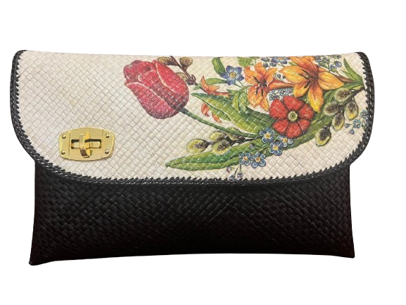
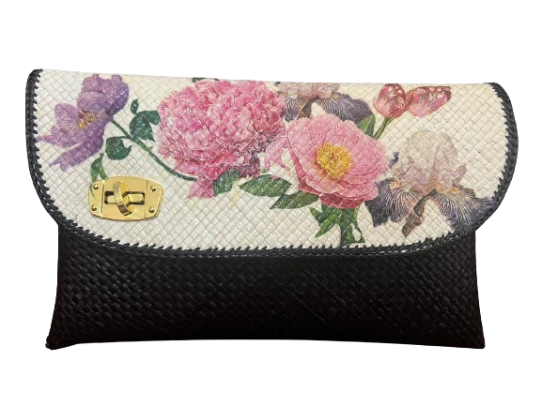
Clutch Decoupage
46012900
  To maintain the beauty and quality of the Bag, store the Bag in a dry area, wrap it in a cloth to protect it from dust, and clean it regularly using a cloth or soft tissue.
lycryxdecoupage.pkl@gmail.com
+62 856 4010 6027
@lycryxdecoupage.pkl

Slide 27
Clutch Decoupage
46012900
Clutch Decoupage is an elegant and fashionable bag, it is very suitable for party and sightseeing events. With a lightweight, simple, and practical design, this clutch is the perfect accessory to complement your look on various occasions.
Material: Full Pandan Leaf Woven
Color : Bone White/Natural White Combination Black
(Purple, Red, Blue, Black, Pink, Green Color Combination)
Size : Pj 32 cm, Height 19 cm
Accessories : Chain Strap (113 cm)
Weight : 280 gr
Motif : Flower
Production Capacity : 100 units/month (Plus Decoupage)
Production Process Time : 1 Month
  To maintain the beauty and quality of the Bag, store the Bag in a dry area, wrap it in a cloth to protect it from dust, and clean it regularly using a cloth or soft tissue.
lycryxdecoupage.pkl@gmail.com
+62 856 4010 6027
@lycryxdecoupage.pkl

Slide 28
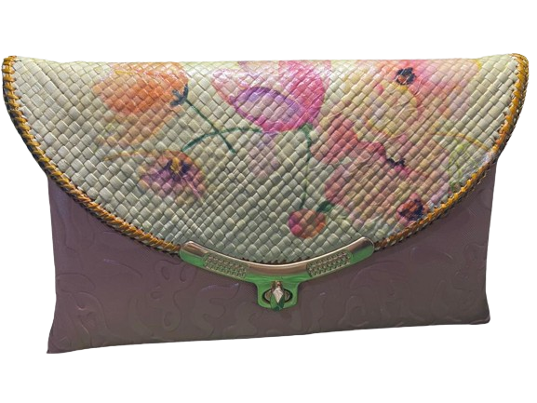
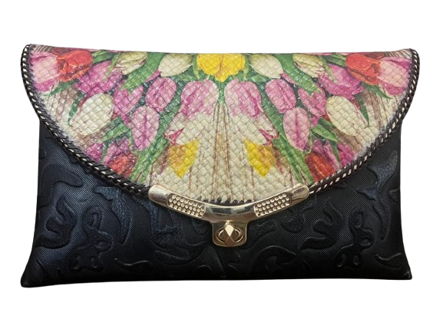
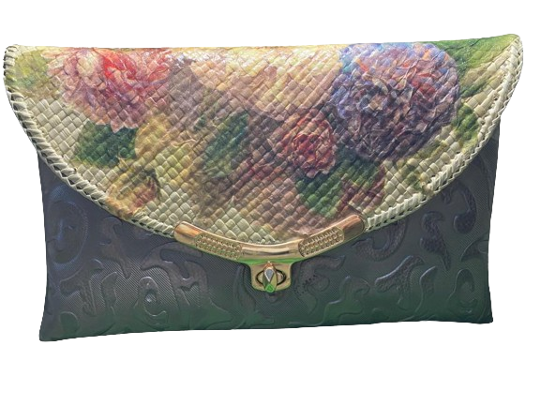
46012900
Clutch Decoupage
  To maintain the beauty and quality of the Bag, store the Bag in a dry area, wrap it in a cloth to protect it from dust, and clean it regularly using a cloth or soft tissue.
lycryxdecoupage.pkl@gmail.com
+62 856 4010 6027
@lycryxdecoupage.pkl

Slide 29
Clutch Decoupage
46012900
Clutch Decoupage is an elegant and fashionable bag, it is very suitable for party and sightseeing events. With a lightweight, simple, and practical design, this clutch is the perfect accessory to complement your look on various occasions.
Material: Combination of Woven Pandan Leaves & Imitation Croco
Color : Bone White/Natural White Combination Black
(Purple, Red, Blue, Black, Pink, Green Color Combination)
Size : Pj 31 cm, Height 19 cm
Accessories : Chain Strap (116 cm)
Weight : 220 gr
Motif : Flower
Production Capacity : 100 units/month (Plus Decoupage)
Production Process Time : 2 Months
  To maintain the beauty and quality of the Bag, store the Bag in a dry area, wrap it in a cloth to protect it from dust, and clean it regularly using a cloth or soft tissue.
lycryxdecoupage.pkl@gmail.com
+62 856 4010 6027
@lycryxdecoupage.pkl

Slide 30
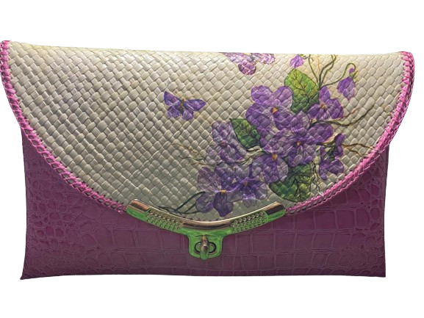
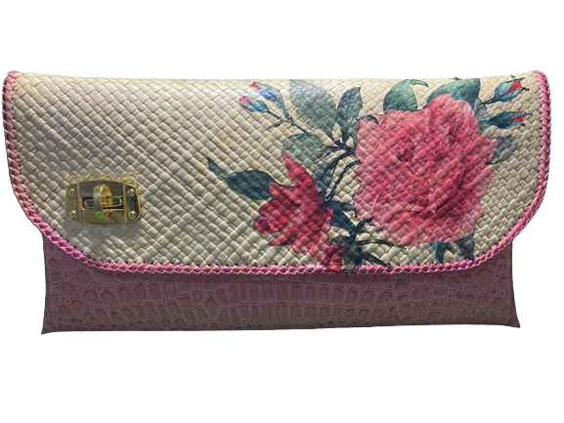
46012900
Clutch Decoupage
  To maintain the beauty and quality of the Bag, store the Bag in a dry area, wrap it in a cloth to protect it from dust, and clean it regularly using a cloth or soft tissue.
lycryxdecoupage.pkl@gmail.com
+62 856 4010 6027
@lycryxdecoupage.pkl

Slide 31
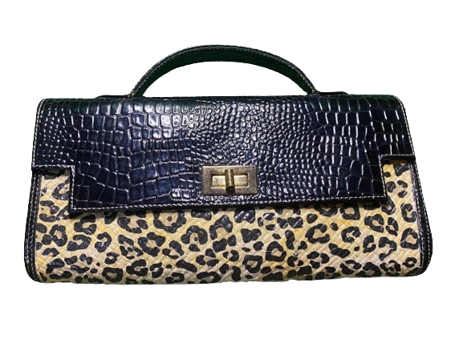
Clutch Decoupage
46012900
Clutch Decoupage is an elegant and fashionable bag, it is very suitable for party and sightseeing events. With a lightweight, simple, and practical design, this clutch is the perfect accessory to complement your look on various occasions.
Material: Combination of Woven Pandan Leaves & Imitation Croco
Color : Bone White/Natural White Combination Black
(Purple, Red, Blue, Black, Pink, Green Color Combination)
Size : Pj 30 cm, Height 16 cm
Accessories : Handle Imitation Croco Material
Weight : 200 gr
Motif : Abstract
Production Capacity : 100 units/month (Plus Decoupage)
Production Process Time :2 Months
  To maintain the beauty and quality of the Bag, store the Bag in a dry area, wrap it in a cloth to protect it from dust, and clean it regularly using a cloth or soft tissue.
lycryxdecoupage.pkl@gmail.com
+62 856 4010 6027
@lycryxdecoupage.pkl

Slide 32
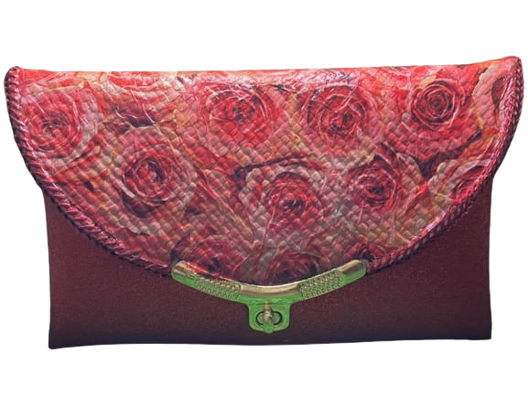
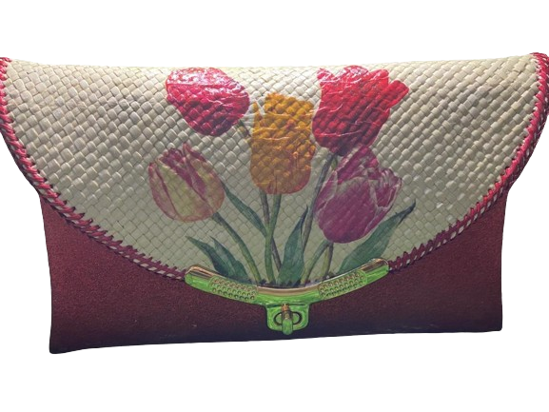
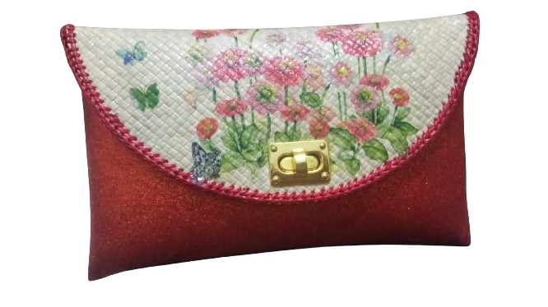
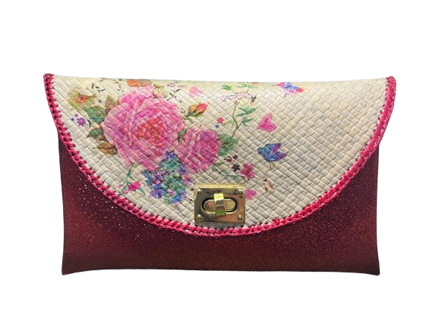

Clutch Small Decoupage
46012900
To maintain the beauty and quality of the Bag, store the Bag in a dry area, wrap it in a cloth to protect it from dust, and clean it regularly using a cloth or soft tissue.
lycryxdecoupage.pkl@gmail.com
+62 856 4010 6027
@lycryxdecoupage.pkl

Slide 33
Clutch Small Decoupage
46012900
Clutch Decoupage is an elegant and fashionable bag, it is very suitable for party and sightseeing events. With a lightweight, simple, and practical design, this clutch is the perfect accessory to complement your look on various occasions.
Ingredients: Combination of Pandan Leaf Woven & Croco Imitation Gliter
Color : Bone White/Natural White Combination & Red
(Purple, Red, Blue, Black, Pink, Green Color Combination)
Size: Pj 28 cm, Height 17 cm. Width 5 cm
Accessories : Chain Strap (113 cm)
Weight : 200 gr
Motif : Flower
Production Capacity : 100 units/month (Plus Decoupage)
Production Process Time : 2 Months
To maintain the beauty and quality of the Bag, store the Bag in a dry area, wrap it in a cloth to protect it from dust, and clean it regularly using a cloth or soft tissue.
lycryxdecoupage.pkl@gmail.com
+62 856 4010 6027
@lycryxdecoupage.pkl

Slide 34




Clutch Small Decoupage
46012900
To maintain the beauty and quality of the Bag, store the Bag in a dry area, wrap it in a cloth to protect it from dust, and clean it regularly using a cloth or soft tissue.
lycryxdecoupage.pkl@gmail.com
+62 856 4010 6027
@lycryxdecoupage.pkl

Slide 35
Clutch Small Decoupage
46012900
Clutch Decoupage is an elegant and fashionable bag, it is very suitable for party and sightseeing events. With a lightweight, simple, and practical design, this clutch is the perfect accessory to complement your look on various occasions.
Ingredients: Combination of Pandan Leaf Woven & Croco Imitation Gliter
Color : Bone White/Natural White Combination & Black
(Purple, Red, Blue, Black, Pink, Green Color Combination)
Size: Pj 28 cm, Height 17 cm. Width 5 cm
Accessories : Chain Strap (113 cm)
Weight : 200 gr
Motif : Flower
Production Capacity : 100 units/month (Plus Decoupage)
Production Process Time : 2 Months
To maintain the beauty and quality of the Bag, store the Bag in a dry area, wrap it in a cloth to protect it from dust, and clean it regularly using a cloth or soft tissue.
lycryxdecoupage.pkl@gmail.com
+62 856 4010 6027
@lycryxdecoupage.pkl

Slide 36



Clutch Small Decoupage
46012900
To maintain the beauty and quality of the Bag, store the Bag in a dry area, wrap it in a cloth to protect it from dust, and clean it regularly using a cloth or soft tissue.
lycryxdecoupage.pkl@gmail.com
+62 856 4010 6027
@lycryxdecoupage.pkl

Slide 37
Clutch Small Decoupage
46012900
Clutch Decoupage is an elegant and fashionable bag, it is very suitable for party and sightseeing events. With a lightweight, simple, and practical design, this clutch is the perfect accessory to complement your look on various occasions.
Ingredients: Combination of Pandan Leaf Woven & Croco Imitation Gliter
Color : Bone White/Natural White Combination & Blue
(Purple, Red, Blue, Black, Pink, Green Color Combination)
Size: Pj 28 cm, Height 17 cm. Width 5 cm
Accessories : Chain Strap (113 cm)
Weight : 200 gr
Motif : Flower
Production Capacity : 100 units/month (Plus Decoupage)
Production Process Time : 2 Months
To maintain the beauty and quality of the Bag, store the Bag in a dry area, wrap it in a cloth to protect it from dust, and clean it regularly using a cloth or soft tissue.
lycryxdecoupage.pkl@gmail.com
+62 856 4010 6027
@lycryxdecoupage.pkl

Slide 38



Clutch Small Decoupage
46012900
To maintain the beauty and quality of the Bag, store the Bag in a dry area, wrap it in a cloth to protect it from dust, and clean it regularly using a cloth or soft tissue.
lycryxdecoupage.pkl@gmail.com
+62 856 4010 6027
@lycryxdecoupage.pkl

Slide 39
Clutch Small Decoupage
46012900
Clutch Decoupage is an elegant and fashionable bag, it is very suitable for party and sightseeing events. With a lightweight, simple, and practical design, this clutch is the perfect accessory to complement your look on various occasions.
Ingredients: Combination of Pandan Leaf Woven & Croco Imitation Gliter
Color : Bone White/Natural White Combination & Purple
(Purple, Red, Blue, Black, Pink, Green Color Combination)
Size: Pj 28 cm, Height 17 cm. Width 5 cm
Accessories : Chain Strap (113 cm)
Weight : 200 gr
Motif : Flower
Production Capacity : 100 units/month (Plus Decoupage)
Production Process Time : 2 Months
To maintain the beauty and quality of the Bag, store the Bag in a dry area, wrap it in a cloth to protect it from dust, and clean it regularly using a cloth or soft tissue.
lycryxdecoupage.pkl@gmail.com
+62 856 4010 6027
@lycryxdecoupage.pkl

Slide 40






Dompet Coin Decoupage
46012900
Decoupage coin wallets are the perfect choice for souvenirs, ideal for storing coins as well as cards. With its small, simple, and lightweight size, this wallet is very practical and easy to carry anywhere.
Material: Full Pandan Leaf Woven
Color : Bone White/Natural White Color combination
(Red, Green, Blue, Pink, Brown color combination)
Size : Pj 15 cm, Lb 5 cm, Tg 7 Cm
Accessories : Zippers (15 cm), Straps (26 cm)
Weight : 25 gr
Motif : Flowers & Fruit
Production Capacity : 300 units/month (plus Decoupage)
Production Process Time : 1 Month
To maintain the beauty and quality of the Bag, store the Bag in a dry area, wrap it in a cloth to protect it from dust, and clean it regularly using a cloth or soft tissue.
lycryxdecoupage.pkl@gmail.com
+62 856 4010 6027
@lycryxdecoupage.pkl

Slide 41

Tissue Box Decoupage
46012900
Decoupage tissue boxes are perfect for placing anywhere, whether at home, office, school, or any other place, providing an elegant and practical touch of art in every room.
Material: Full Pandan Leaf Woven
Color : Bone White
Size Tissue Box: Lid - Pj 24 cm, Lb 13 cm, Tg 3 cm,
Bottom - Pj 23 cm, Lb 12 cm, Tg 7 cm
Aqua Place Size: Lid - Pj 30.5 cm, Lb 30.5 cm, Tg 10 cm,
Weight : 500 gr
Accessories : Wooden Handle
Motif : Leaves & Butterflies
Production Capacity : 100 units/month (plus decoupage)
Production Process Time : 1 month
  To maintain the beauty and quality of the Bag, store the Bag in a dry area, wrap it in a cloth to protect it from dust, and clean it regularly using a cloth or soft tissue.
lycryxdecoupage.pkl@gmail.com
+62 856 4010 6027
@lycryxdecoupage.pkl

Slide 42

Tissue Box Decoupage
46012900
Decoupage tissue boxes are perfect for placing anywhere, whether at home, office, school, or any other place, providing an elegant and practical touch of art in every room.
Material: Full Pandan Leaf Woven
Color : Combination of Bone White and Red
(And many other color options)
Size : Lid - Pj 24 cm, Lb 13 cm, Tg 3 cm,
Bottom - Pj 23 cm, Lb 12 cm, Tg 7 cm
Weight : 250 gr
Motif : Fruit
Production Capacity : 100 units/month (plus decoupage)
Production Process Time : 1 month
  To maintain the beauty and quality of the Bag, store the Bag in a dry area, wrap it in a cloth to protect it from dust, and clean it regularly using a cloth or soft tissue.
lycryxdecoupage.pkl@gmail.com
+62 856 4010 6027
@lycryxdecoupage.pkl

Slide 43






Tissue Box Decoupage
46012900
  To maintain the beauty and quality of the Bag, store the Bag in a dry area, wrap it in a cloth to protect it from dust, and clean it regularly using a cloth or soft tissue.
lycryxdecoupage.pkl@gmail.com
+62 856 4010 6027
@lycryxdecoupage.pkl

Slide 44
Tissue Box Decoupage
46012900
Decoupage tissue boxes are perfect for placing anywhere, whether at home, office, school, or any other place, providing an elegant and practical touch of art in every room.
Material: Full Pandan Leaf Woven
Color : Bone White
(And many other color options)
Size : Lid - Pj 24 cm, Lb 13 cm, Tg 3 cm,
Bottom - Pj 23 cm, Lb 12 cm, Tg 7 cm
Weight : 250 gr
Motif : Flower
Production Capacity : 100 units/month (plus decoupage)
Production Process Time : 1 month
  To maintain the beauty and quality of the Bag, store the Bag in a dry area, wrap it in a cloth to protect it from dust, and clean it regularly using a cloth or soft tissue.
lycryxdecoupage.pkl@gmail.com
+62 856 4010 6027
@lycryxdecoupage.pkl

Slide 45



Thank You
"Handcrafted items infused with artistic flair evoke the soul of creativity."
@lycryxdecoupage
0856 4010 6027
Perumahan Bina Griya Indah Jl Elok
Kota Pekalongan, Jawa Tengah, indonesia

