Slide 1
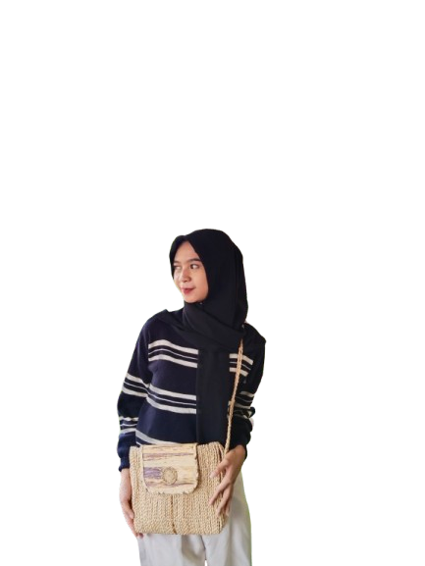
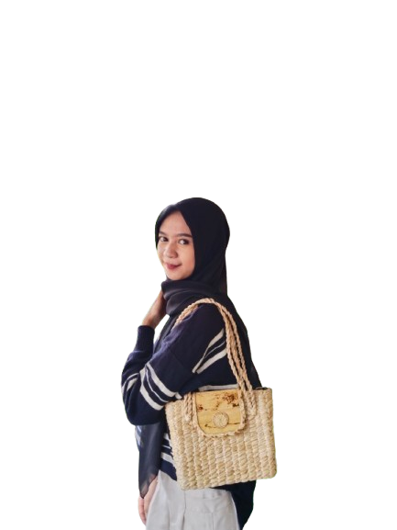




L Y C R YX C R A F T
catalog
lycryxdecoupage.pkl@gmail.com
+62 856 4010 6027
@lycryxdecoupage.pkl

Slide 2
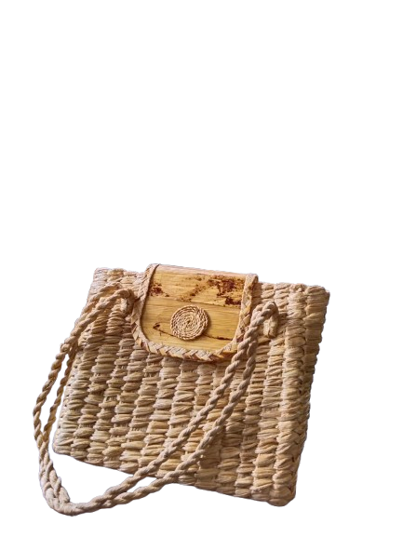
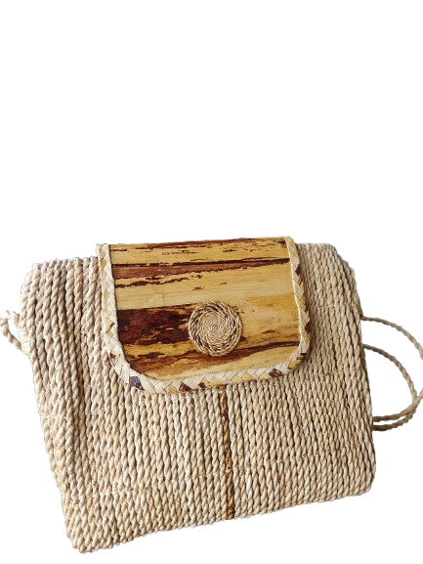
46012900
Limbah Pelepah Pisang
lycryxdecoupage.pkl@gmail.com
+62 856 4010 6027
@lycryxdecoupage.pkl

Slide 3
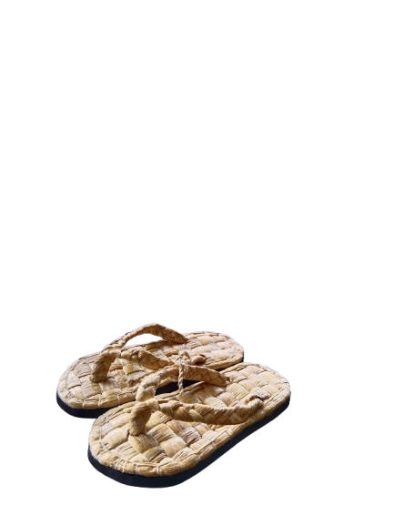
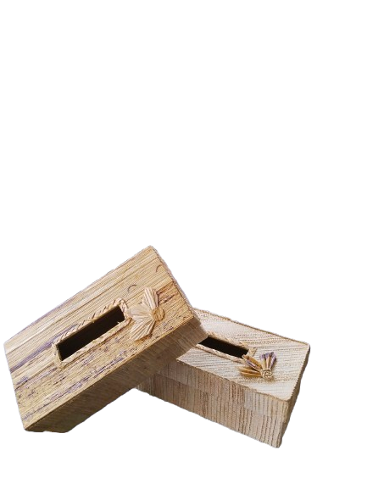
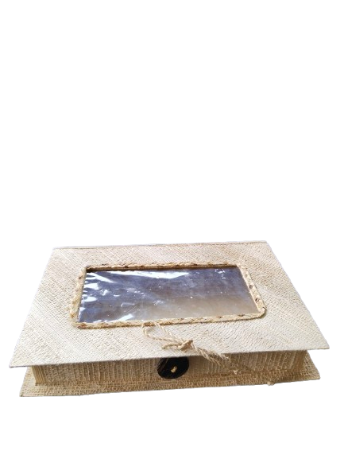
46012900
Limbah Pelepah Pisang
lycryxdecoupage.pkl@gmail.com
+62 856 4010 6027
@lycryxdecoupage.pkl

Slide 4
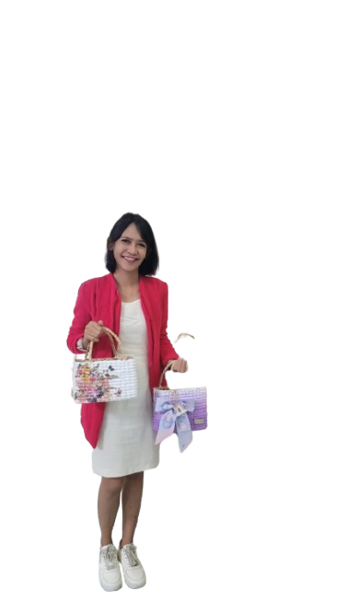
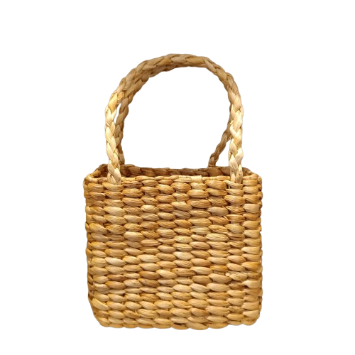
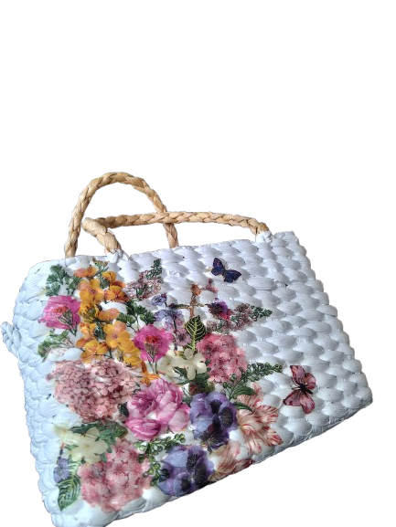
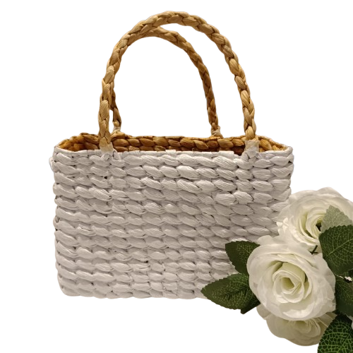
Gedebok Pisang
46012900
lycryxdecoupage.pkl@gmail.com
+62 856 4010 6027
@lycryxdecoupage.pkl

Slide 5

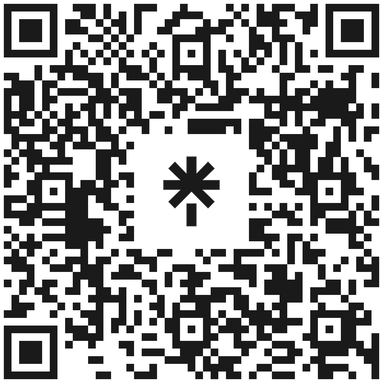

3926.90
Thank You
"Handcrafted items infused with artistic flair evoke the soul of creativity."
@lycryxdecoupage
0856 4010 6027
Perumahan Bina Griya Indah Jl Elok
Kota Pekalongan, Jawa Tengah, indonesia

